Slide 1
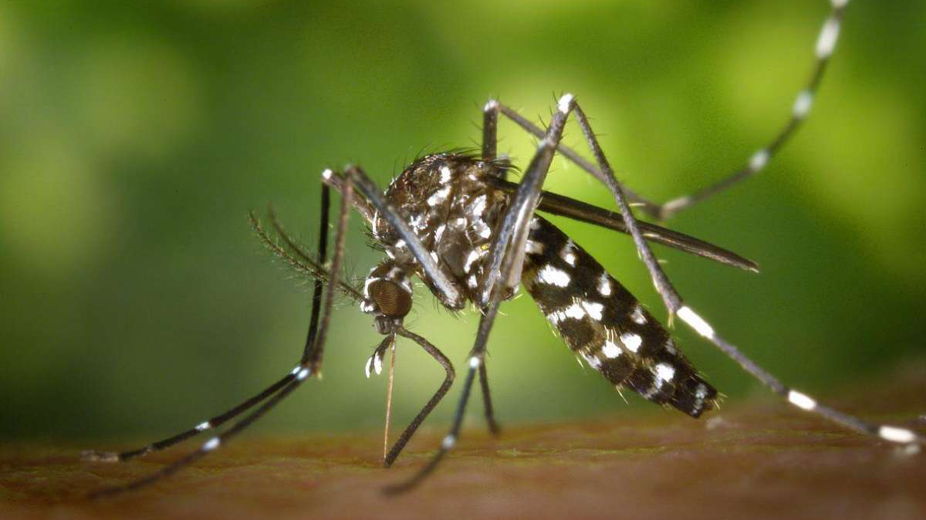
An Analysis To Predict The Occurrence Of The West Nile Virus Using Classifier Models
Bing Ming
Khalis
Casper

Slide 2
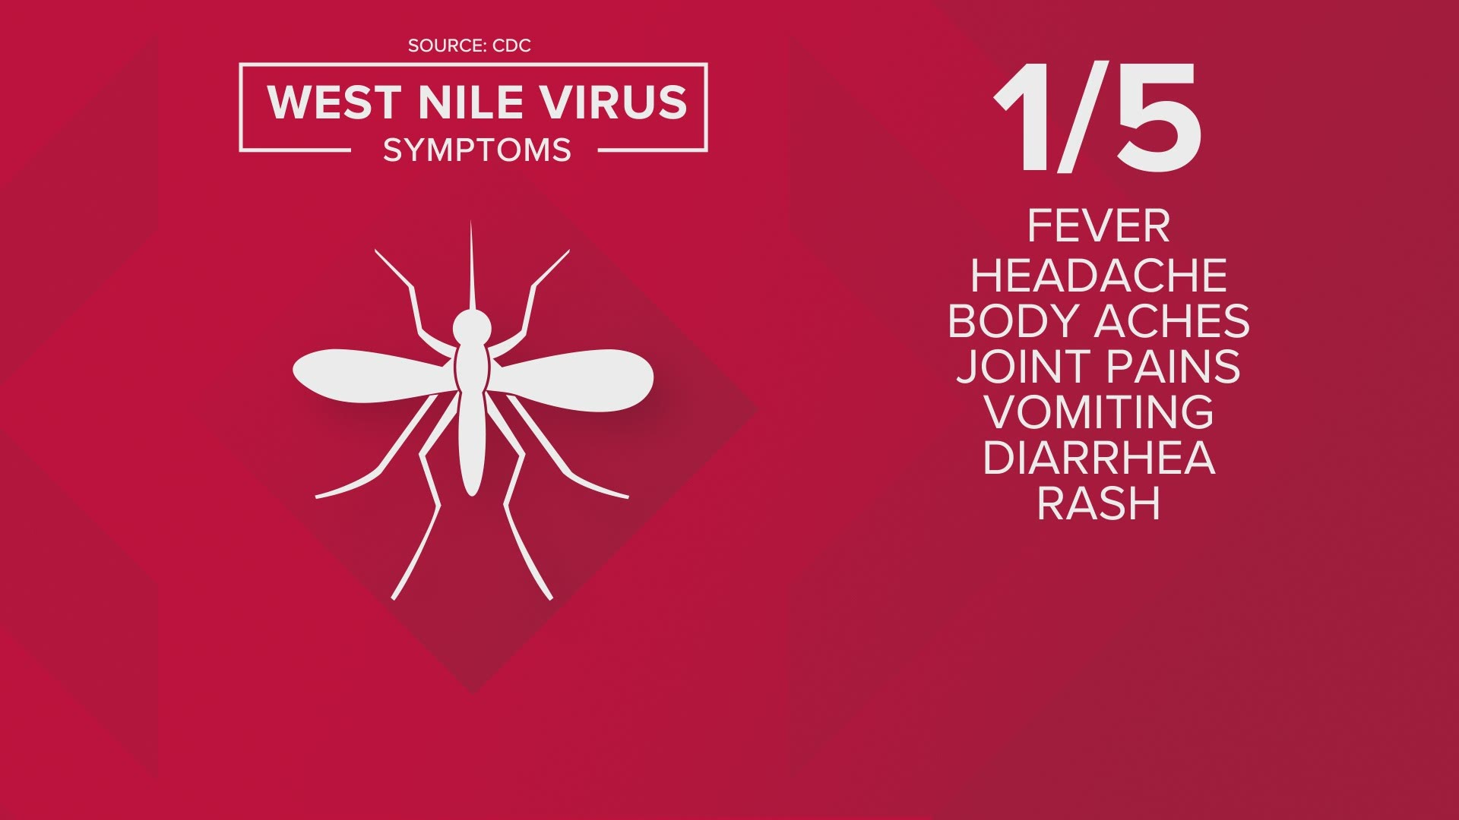








Problem Statement
Cleaning & Imputation
EDA & Findings
Modeling
Cost-Benefit Analysis
Conclusion & Recommendation

Slide 3

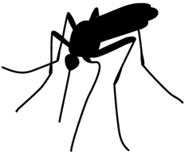
Problem Statement
Due to the recent epidemic of West Nile Virus in Chicago, the Department of Public Health set up a surveillance and control system to help collect data on mosquito numbers, West Nile Virus appearance, and weather events.
We have been tasked to assess the viability of the current spray model, as well as to try and predict occurrence of West Nile Virus in Chicago by training classification models.
Notes:
Our project will seek to:
Determine the effectiveness of sprays on the mosquito population
Predict the occcurence of West Nile Virus
Help provide guidelines by which to apply future sprays
4.conduct a cost benefit analysis on the use of the pesticides in response to the epidemic

Slide 4

Cleaning & Imputation
Drop null rows
Feature Selection
Feature Engineering
Text
Text
Text

Slide 5

Insights into the data
Text
Text
Text

Slide 6
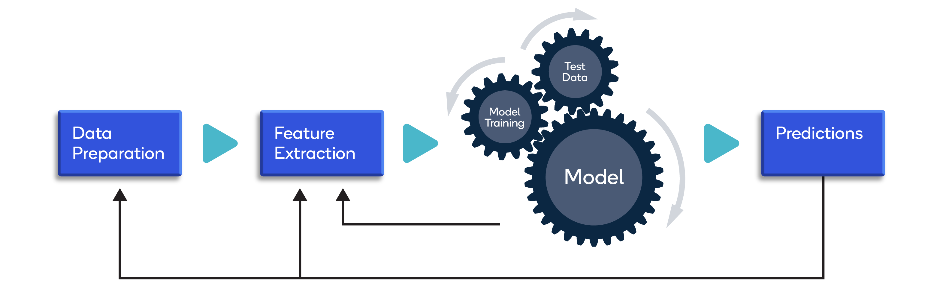
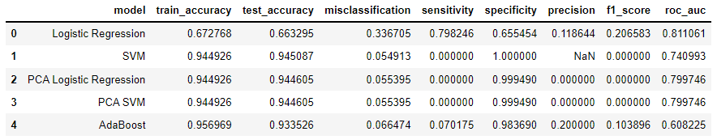
Logistic Regression performed the best in terms of ROC-AUC score

Slide 7
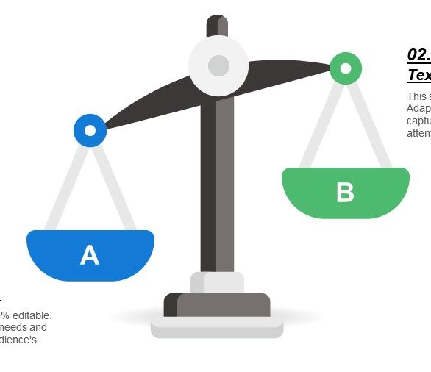






Cost outweighs benefits in our analysis
Scenario: we sprayed across the entire Chicago city in 2013.
Instead of 66 human infected cases, there were none.
Productivity loss :
US$7,500
Spraying:
US$1.17 million
Healthcare Medical Costs: Negligible
Benefit
Cost
Notes:
Cost: Zenivex, $0.67 per acre, totalling $1.17 million if sprayed every week for 3 months during summer period

Slide 8

Recommendation & Conclusion
We conclude:
We recommend:

